Slide 1
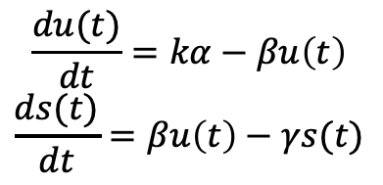
$$\frac{du(t)}{dt}=kα−βu\left(t\right)$$
$$\frac{ds(t)}{dt}=βu\left(t\right)−γs(t)$$
Improvements on velocity models:
Estimation of transcriptional rate (modeling as cell-specific transcriptional rate, conditional on CRE accessibility (multiVelo), or cell state (VeloVAE), or using metabolic labeling (dynamo))
Unified time scale (not gene specific time, VeloVAE, UniTVelo)
For interpretability, only focus on those model which fit the phase portrait of each gene to infer velocity on gene level. But not model the velocity as the latent representation.

Slide 2
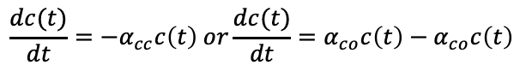
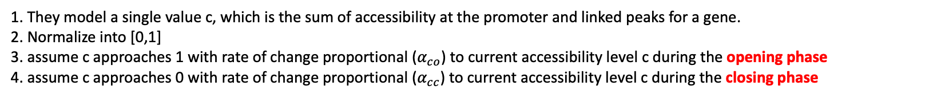
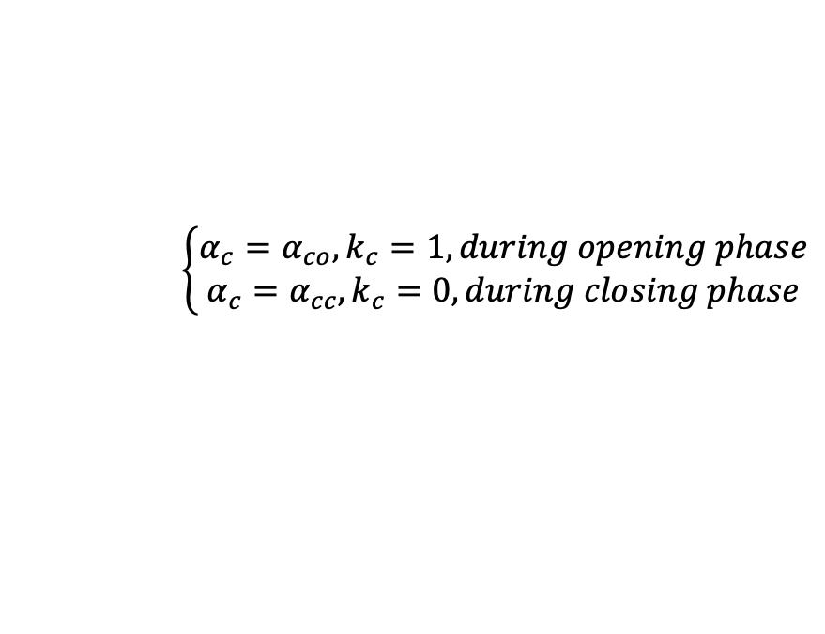
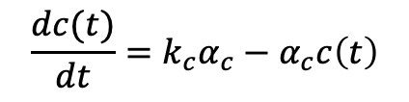
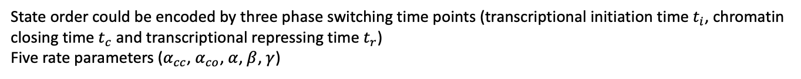
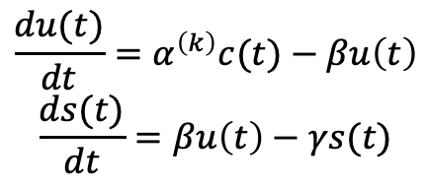
MultiVelo
1. They model a single value c, which is the sum of accessibility at the promoter and linked peaks for a gene.
2. Normalize into [0,1]
3. assume c approaches 1 with rate of change proportional ($α_{co}$) to current accessibility level c during the opening phase
4. assume c approaches 0 with rate of change proportional ($α_{cc}$) to current accessibility level c during the closing phase
$$\frac{dc(t)}{dt}=−α_{cc}c\left(t\right) or\frac{dc(t)}{dt}=α_{co}c\left(t\right)−α_{co}c\left(t\right)$$
5. could be written into one equation
$$\frac{dc(t)}{dt}=k_{c}α_{c}−α_{c}c\left(t\right)$$
$$\left\{\begin{aligned}α_{c}=α_{co}, k_{c}=1, during opening phase \\ α_{c}=α_{cc},k_{c}=0, during closing phase\end{aligned}\right.$$
$$\frac{du(t)}{dt}=α^{\left(k\right)}c(t)−βu\left(t\right)$$
$$\frac{ds(t)}{dt}=βu\left(t\right)−γs(t)$$
6. Includes two latent variable: chromatin state $k_{c}$ and RNA state $k$. Labeling possible orders as two types of models M1 and M2
$$M1:\left(k_{c}=1,k=0\right)→\left(k_{c}=1,k=1\right)→\left(k_{c}=0,k=1\right)→\left(k_{c}=0,k=0\right)$$
$$M2:\left(k_{c}=1,k=0\right)→\left(k_{c}=1,k=1\right)→\left(k_{c}=1,k=0\right)→\left(k_{c}=0,k=0\right)$$
State order could be encoded by three phase switching time points (transcriptional initiation time $t_{i}$, chromatin closing time $t_{c}$ and transcriptional repressing time $t_{r}$)
Five rate parameters ($α_{cc}$, $α_{co}$, $α$, $β$, $γ$)

Slide 3
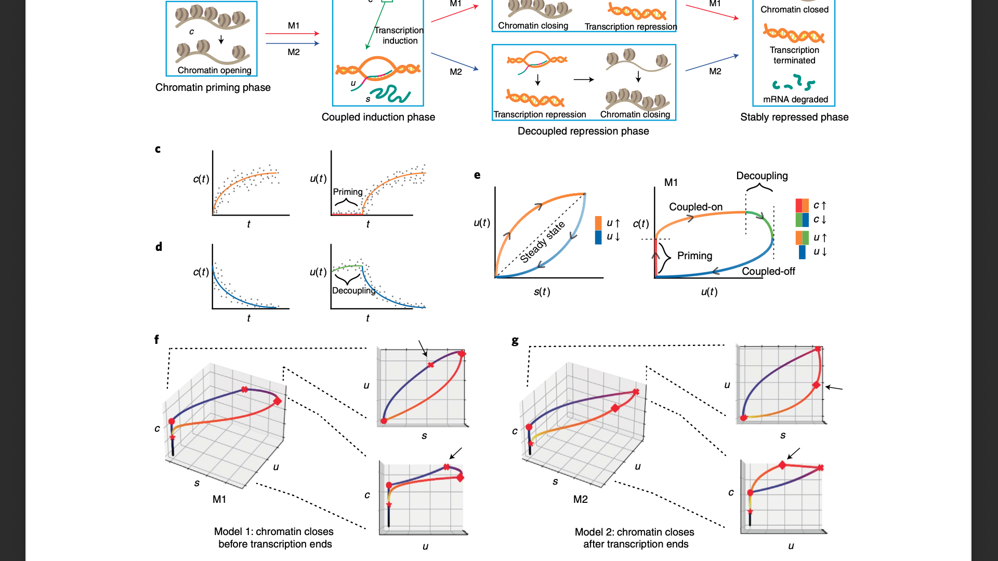
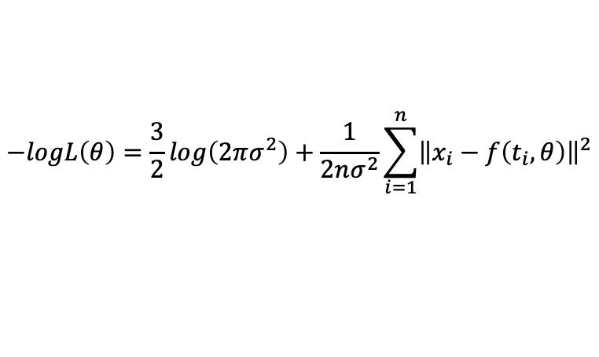
7. Define ODE prediction as $f\left(t_{i},θ\right)={\hat{x}}_{i}=\left({\hat{c}}_{i},{\hat{u}}_{i},{\hat{s}}_{i}\right)$, modeling ${\hat{x}}_{i}$ as gaussian distribution, we can maximize the likelihood function
$$−logL\left(θ\right)=\frac{3}{2}log\left(2πσ^{2}\right)+\frac{1}{2nσ^{2}}\sum_{i=1}^{n}{{\left\|x_{i}−f\left(t_{i},θ\right)\right\|}^{2}}$$
8. Updating the parameter through EM.
Key point of MultiVelo (from myside):
1. Adding the promoter accessibility information into transcriptional rates.
2. Modeling the life cycle of each gene into four phases but not two
Didn’t consider the TF expression. Still fitting each gene independently
Hard to say the new phase modeling is making sense.

Slide 4
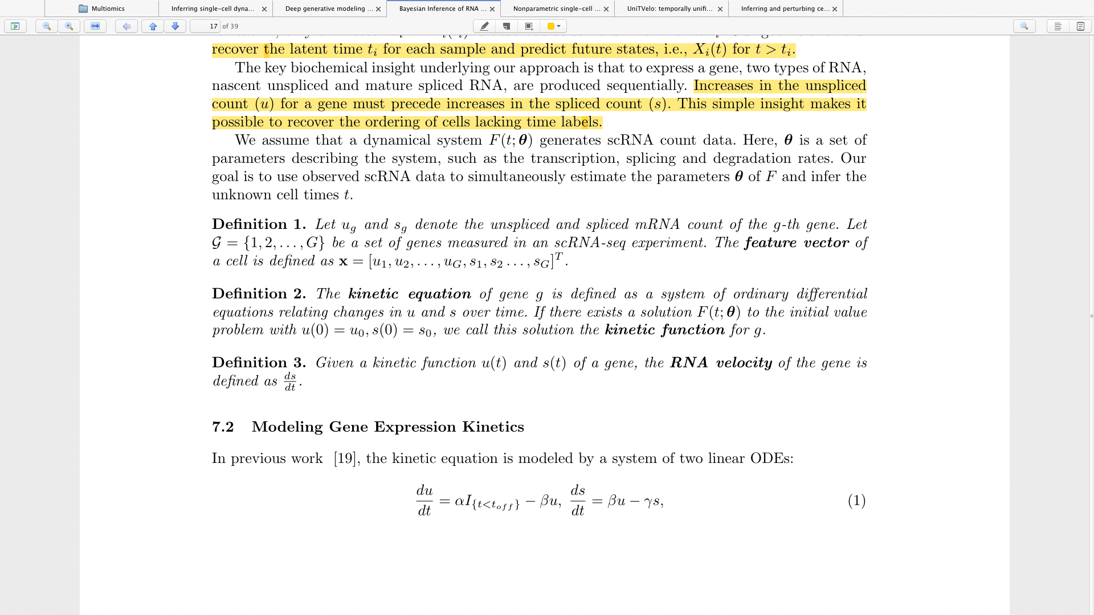
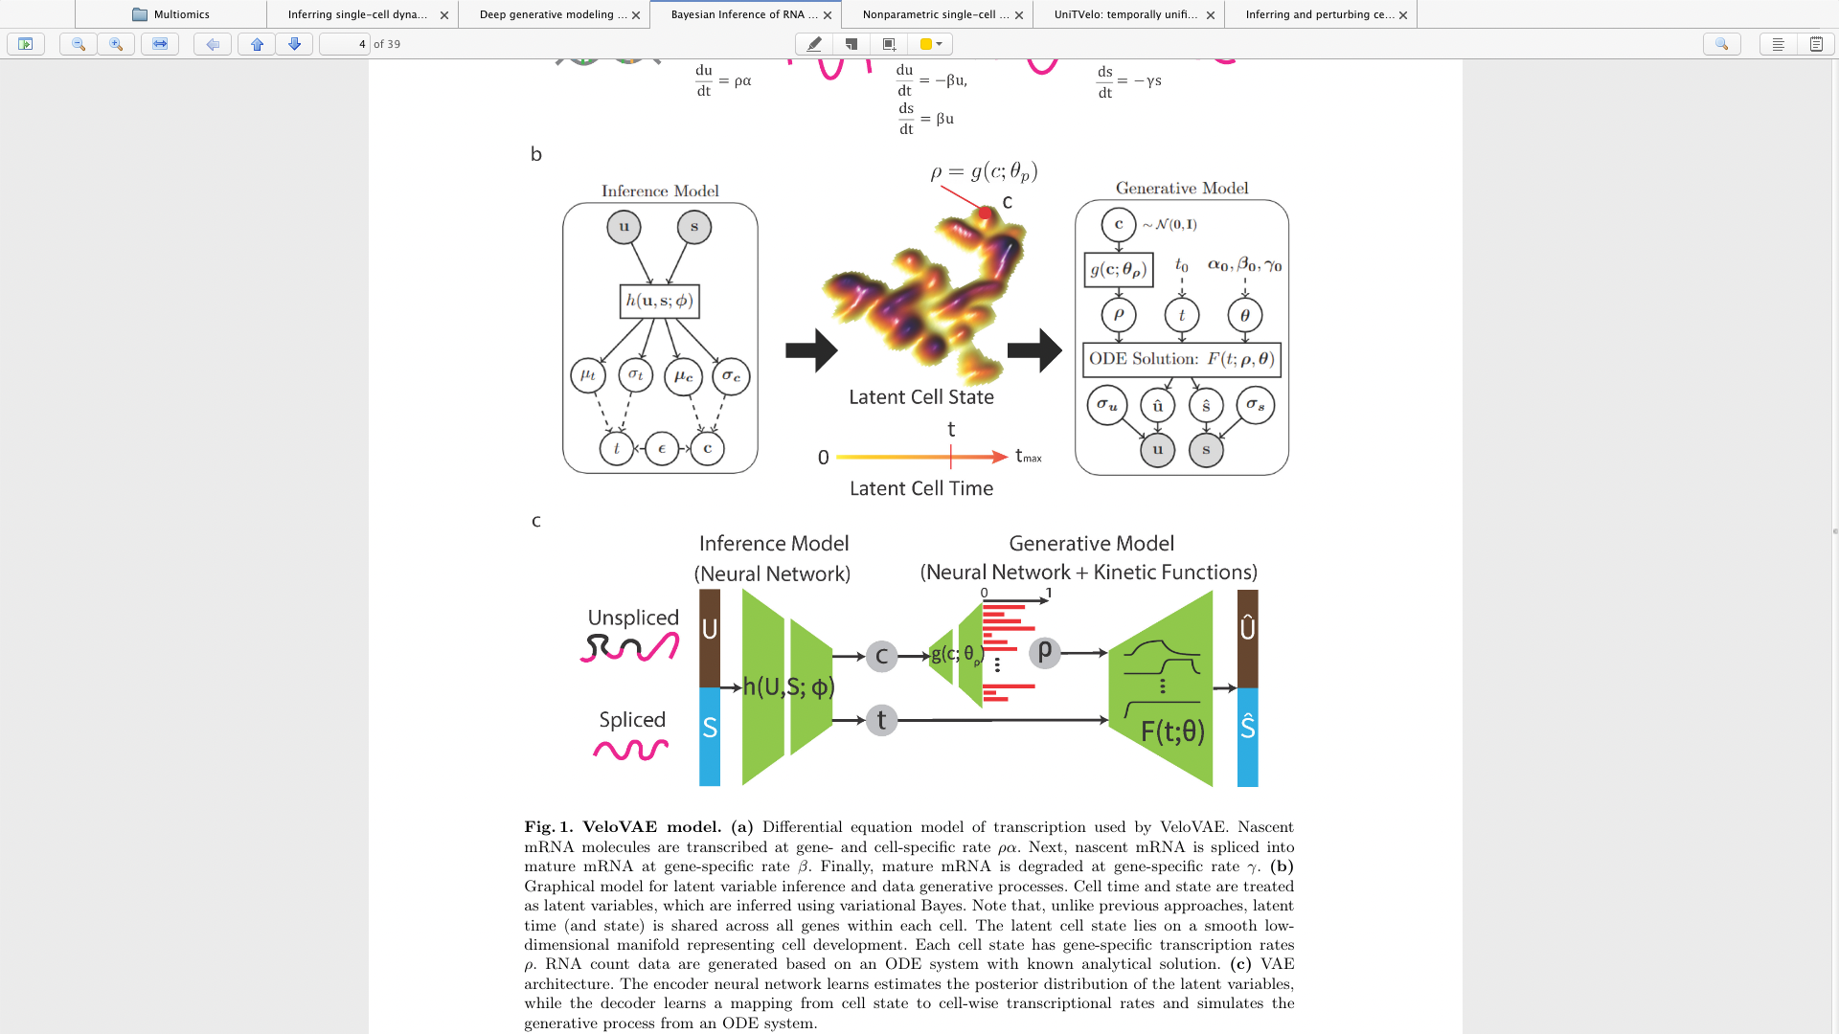
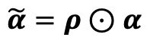
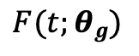
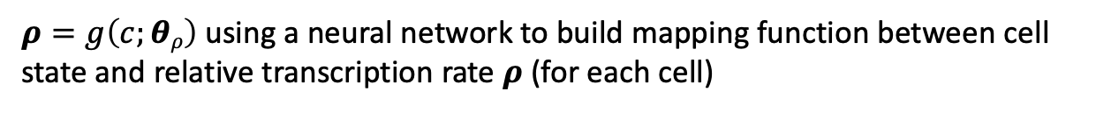
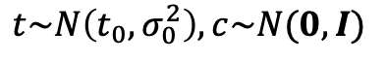
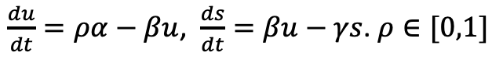
VeloVAE
$$F(t;θg)$$
Analytic solution for the system to the initial value problem with $μ\left(0\right)=u_{0}, s\left(0\right)=s_{0}.$ Call this solution the kinetic function of gene g
$\frac{du}{dt}=ρα−βu$, $\frac{ds}{dt}=βu−γs$. $ρ∈[0,1]$
1. Encode the feature vector x into cell representation c and pseudotime t
$$t\sim N\left(t_{0},σ_{0}^{2}\right), c\sim N(0,I)$$
$ρ=g\left(c;θρ\right)$ using a neural network to build mapping function between cell state and relative transcription rate $ρ$ (for each cell)
$$\tilde{α}=ρ⊙α$$
Fitting other parameter, $β$, $γ$ for each gene, and still shared across cells.
$$\left(θ=[\tilde{α},β,γ]\right)$$
Then decode,
$$x\sim N(F\left(t;θ\right),Σ_{r})$$

Slide 5
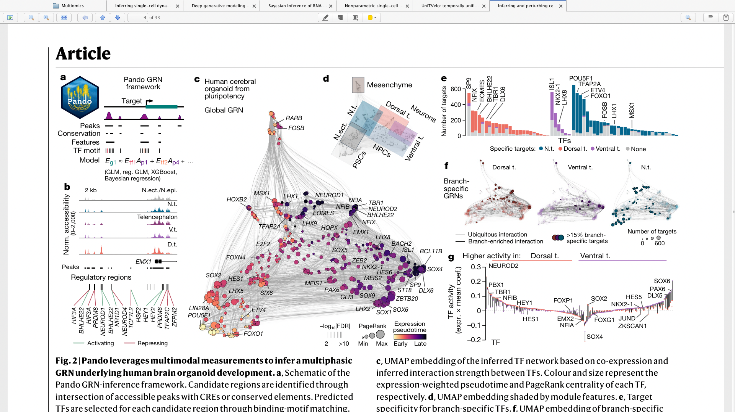
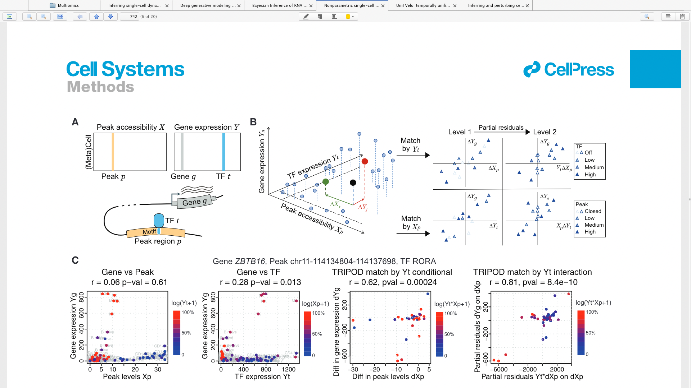
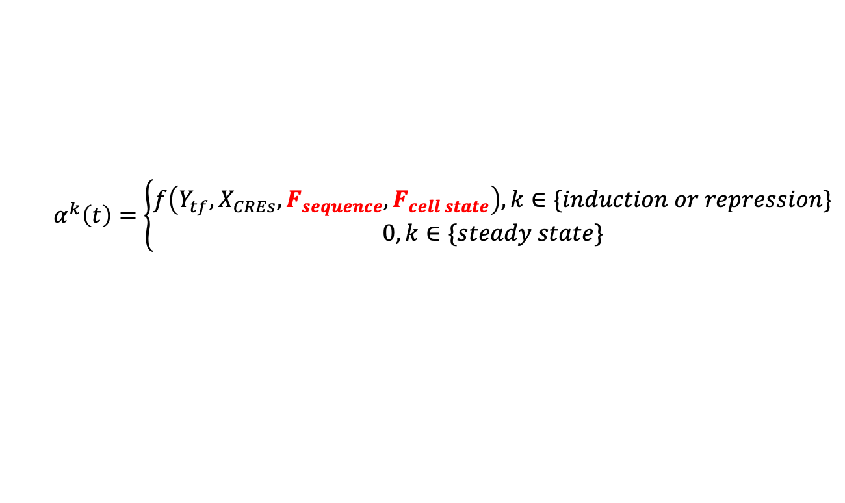
Multiomics model for predicting expression of target genes
Identification of CREs from multiome data
CREs for genes were discovered by linking peaks to genes by co-accessibility and co-expression (LinkPeaks, Signac). Scanning on all regions (default in Pando) or candidate region (defined as evolutionary conserved genomic region (PhastCons) or known regulatory region (annotated by ENCODE).
Identify TF motif on CREs
Gathering TF motif information from database (e.g. JASPAR and CIS-BP). Find motif positions in accessible chromatin regions through motifmatchr.
Initialize regulatory graph between TF, CREs and downstream genes (input multiome dataset)
Using a neural network or introduce new biophysical equation to model transcriptional rate
Considering a sequence representation (Enformer), a pretrain model based on labeling data? (fit a nn mapping function from sequence to Nascent RNA)
Considering a cell state feature through encode cell into latent representation
$$α^{k}\left(t\right)=\left\{\begin{aligned}f\left(Y_{tf},X_{CREs},F_{sequence},F_{cell state}\right), k∈\{induction or repression\} \\ 0,k∈\{steady state\}\end{aligned}\right.$$

Slide 6
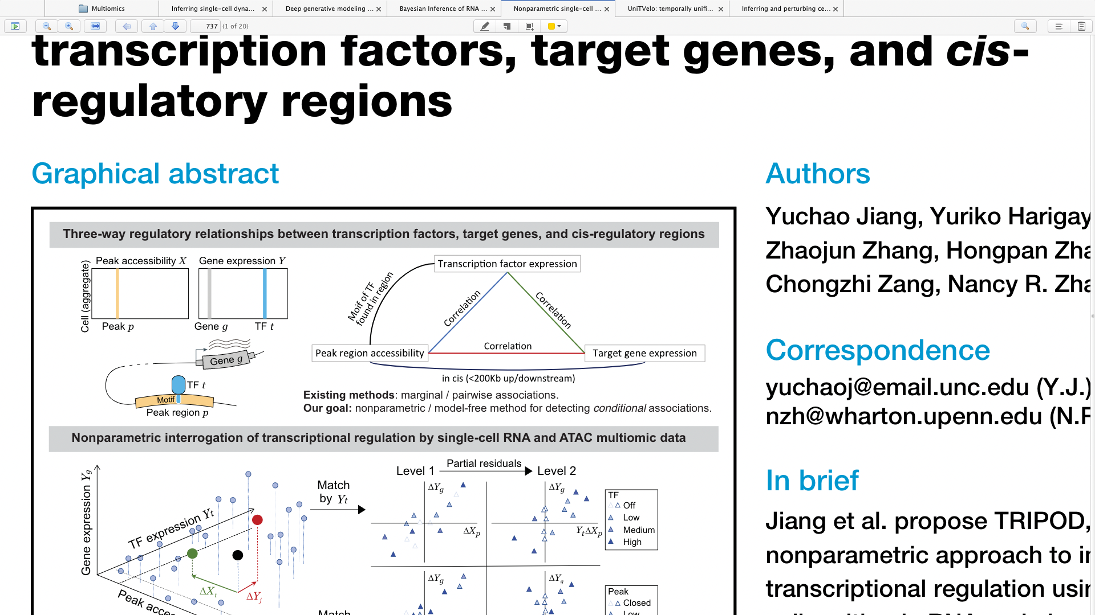
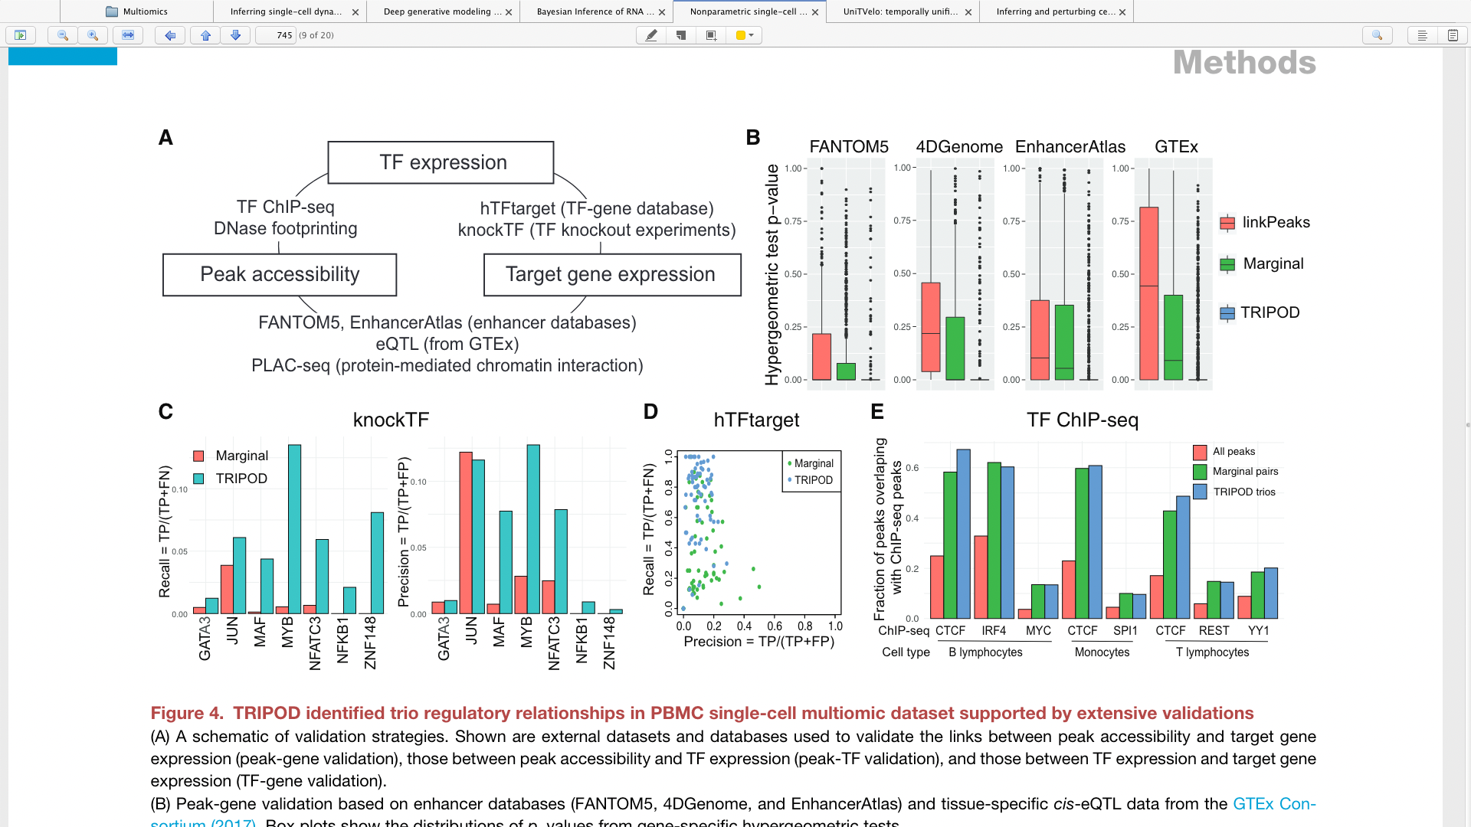

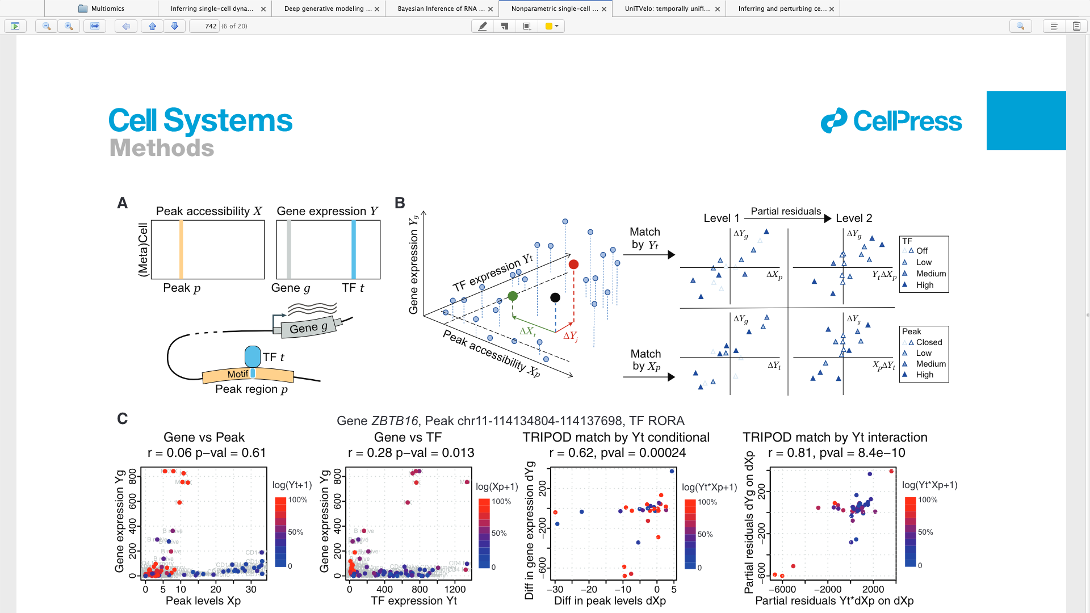
A possible USP
1. Using some feature importance model or some attention based model to ranking the importance of each peak/TF feature to target genes.
2. Comparing some correlation based baseline model, our model would incorporate dynamics, so might enrich more valided or known regulatory relationship
(Benchmarking using external dataset ChIP-seq, cis-eQTL, etc)

Slide 7
